Slide 1

Periodicity and the periodic table
a report by Sean Poston

Slide 2
Outline
Periodicity
History
Lab

Slide 3
periodicity
"The quality, state, or fact of being regularly recurrent or having periods" (Merriam-Webster).
"Regular and predictable variations in element atomic structure" (Helmenstine).
The modern table has many forms of periodicity.

Slide 4
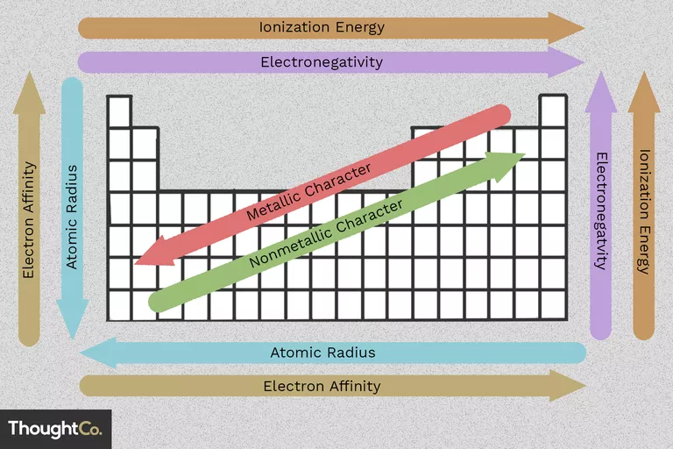

Slide 5
Before mendeleev
Antoine Lavosier's list of 33 chemical elements (1789).
Johann Döbereiner's triads (1829).
Alexandre-Émile Béguyer de Chancourtois was the first to discover periodicity (1862).
Gustavus Hinrichs's spiral periodic system (1867).
Wikipedia

Slide 6
mendeleev
First published periodic table in 1869.
Left gaps in table where it seemed elements could be discovered.
Ignored the ordering by atomic weights.
Updated his table to group similar elements by columns and not rows.
Wikipedia

Slide 7
The modern Periodic Table
Standard form is attributed to Horace Groves Deming (1923).
Rows were attributed to filling quantum shells of electrons.
Most recent elements were officially added in November 2016.
Wikipedia

Slide 8
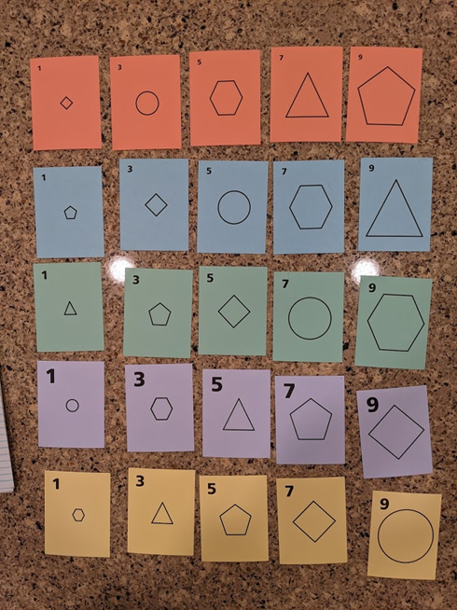
Lab
Organizing cards by color, symbol, or number.

Slide 9
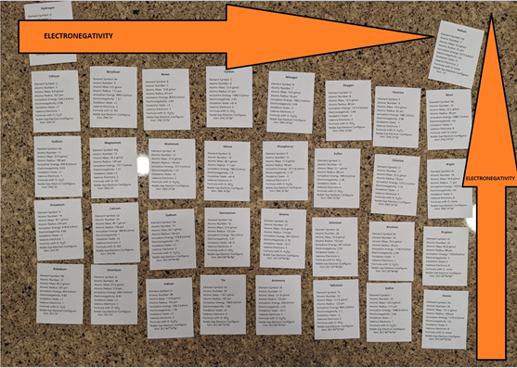
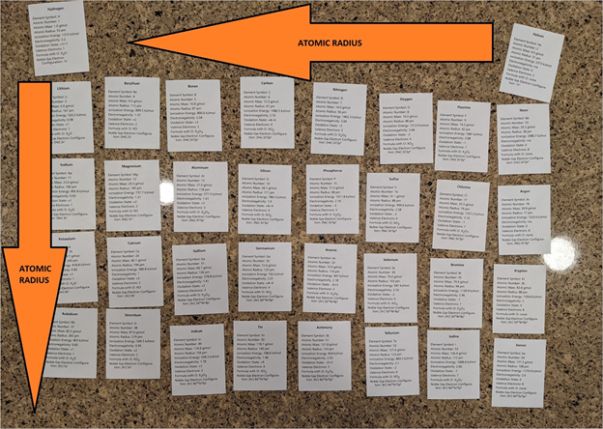
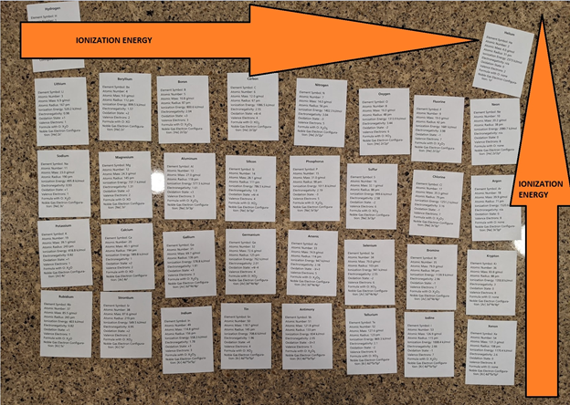
Lab
Organizing cards by atomic mass.

Slide 10
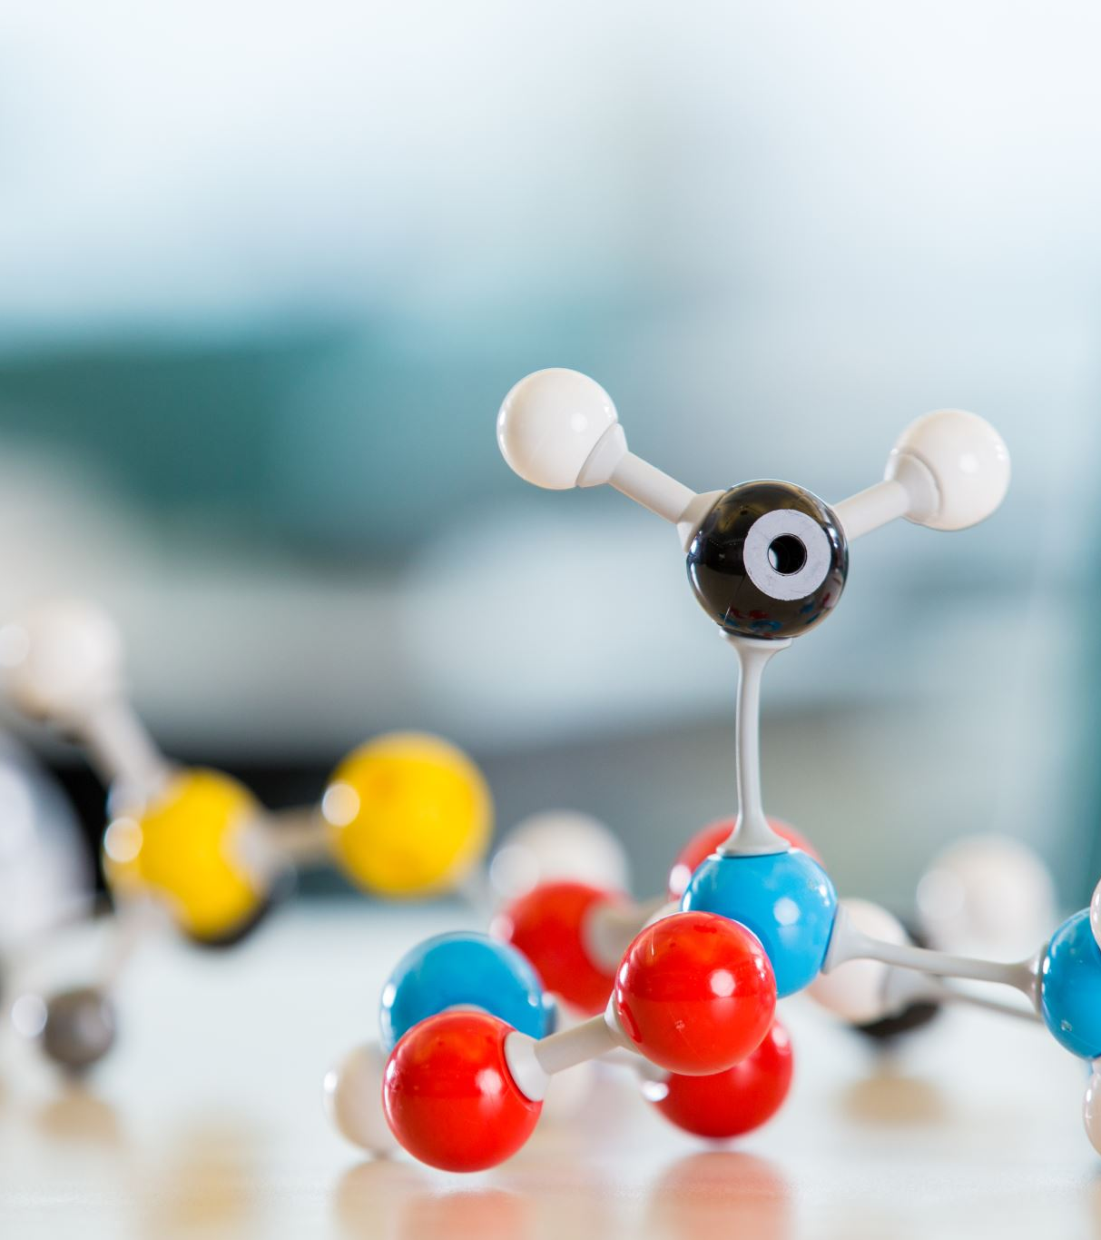
conclusion
The periodic table is a constant work in progress.
Those who aren't well recognized helped pave the way for modern chemistry.
Performing the lab helped me appreciate prior work.

Slide 11
Sources
Periodicity. Merrian-Webster. https://www.merriam-webster.com/dictionary/periodicity.
Helmenstine, Anne Marie, Ph.D. "Periodicity Definition in Chemistry." ThoughtCo, Aug. 26, 2020, thoughtco.com/definition-of-periodicity-604600.
Chart of Periodic Table Trends. ThoughtCo. https://www.thoughtco.com/chart-of-periodic-table-trends-608792.
https://en.wikipedia.org/wiki/Periodic_table#History

Slide 12
Thank you!

